Slide 1
Department of Computer Science and Engineering (CSE)
INSTITUTE : UIE
DEPARTMENT : CSE
Bachelor of Engineering (Computer Science & Engineering)
Programming in Python Lab
(23CSP-201)
DISCOVER . LEARN . EMPOWER

Slide 2
Unit 3 Content
Department of Computer Science and Engineering (CSE)
UNIT-3 | Searching, Sorting, OOP, and File Handling
Experiment 3.1 | Searching algorithms (linear, binary) and sorting techniques (bubble, insertion, selection, merge, quick).
Experiment 3.2 | Object-Oriented Programming: classes, methods, inheritance, and polymorphism.
Experiment 3.3 | File handling: reading, writing, and manipulating files in various modes.

Slide 3
Department of Computer Science and Engineering (CSE)
Course Outcome
CO1 | Describe the basic fundamentals of python programming.
CO2 | Apply the python programming for Arithmetic, Logical and sorting operations.
CO3 | Analyze python programming loops & methods for data manipulation.
CO4 | Use the Python programming language for various programming techniques like list, tuples, dictionaries etc.
CO5 | Develop application software using object-oriented programming techniques in the Python language.
Will be covered in this lecture

Slide 4
OBJECTIVES
Department of Computer Science and Engineering (CSE)
At the completion of this Chapter, students should be able to do the following:
1. Implement and compare searching algorithms (linear, binary) and sorting techniques (bubble, insertion, selection, merge, quick) in Python.
2. Apply Object-Oriented Programming concepts including classes, methods, inheritance, and polymorphism to create efficient Python programs.
3. Perform file handling operations in Python, including reading, writing, and manipulating files in various modes.
4. Develop practical applications that integrate searching, sorting, OOP, and file handling to solve programming problems.
5. Analyze the efficiency of implemented algorithms and choose appropriate techniques for different scenarios.

Slide 5
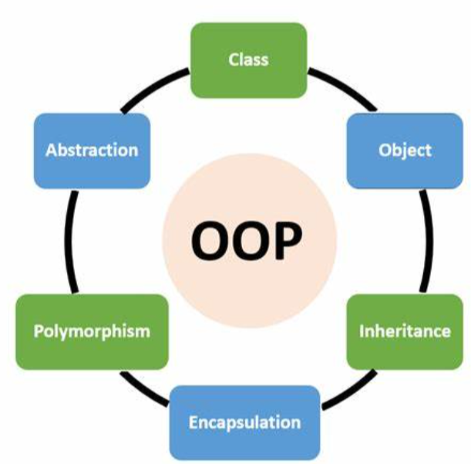
Object Oriented Programming & File Handling
In Python object-oriented Programming (OOPs) is a programming paradigm that uses objects and classes in programming. It aims to implement real-world entities like inheritance, polymorphisms, encapsulation, etc. in the programming.
OOPs Concepts in Python
Class
Objects
Polymorphism
Encapsulation
Inheritance
Data Abstraction

Slide 6
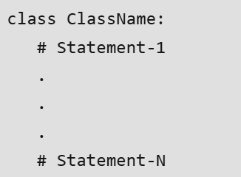
Object Oriented Programming &File Handling
Python Class: A class is a collection of objects. A class contains the blueprints or the prototype from which the objects are being created. It is a logical entity that contains some attributes and methods.
Key points on Python class:
Classes are created by keyword class.
Attributes are the variables that belong to a class.

Slide 7
Object Oriented Programming &File Handling
Python Objects: In object oriented programming Python, The object is an entity that has a state and behavior associated with it. It may be any real-world object like a mouse, keyboard, chair, table, pen, etc. Integers, strings, floating-point numbers, even arrays, and dictionaries, are all objects.
Creating an Object:
This will create an object named obj of the class Dog.
obj = Dog()
The Python _init_ Method : The _init_ method is similar to constructors in C++ and Java. It is run as soon as an object of a class is instantiated. The method is useful to do any initialization you want to do with your object.

Slide 8
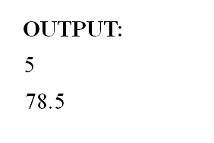
Object Oriented Programming &File Handling
For example, # Python _init_ Method
class circle:
pi=0
r=0
def __init__(self):
self.pi=3.14
self.r=5
def area(self):
print(self.r)
return self.pi*self.r**2
ob1=circle()
print(ob1.area())

Slide 9
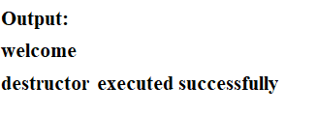
Object Oriented Programming &File Handling
__del__() (Destructor Method): class demo:
def __init__(self):
print("welcome")
def __del__(self):
print("destructor executed successfully")
ob1=demo()
ob2=ob1
del ob1 #you can delete an object by using del keyword
del ob2

Slide 10
Object Oriented Programming &File Handling
Self Parameter and Adding Methods to a class: There is only one difference between class methods and ordinary functions. The self parameter is used in the implementation of the method, but it is not used when the method is called.
Example:
class demo:
def display(self):
print("welcome")
ob1=demo()
ob1.display()
Output:
welcome

Slide 11
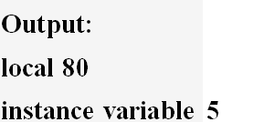
Object Oriented Programming &File Handling
Use of Self:
class demo:
x=5
def display(self,x):
x=x+30
print("local" ,x)
print("instance variable", self.x)
ob1=demo()
ob1.display(50)

Slide 12
Object Oriented Programming &File Handling
Passing an Object as Parameter to a Method: class test:
a=0
b=0
def __init__(self,x,y):
self.a=x
self.b=y
def equals(self,obj):
if obj.a==self.a and obj.b==self.b:

Slide 13
Object Oriented Programming &File Handling
return True
else:
return False
obj1=test(20,30) Output:
obj2=test(20,30) True
obj3=test(10,9) False
print(obj1.equals(obj2))
print(obj1.equals(obj3))

Slide 14
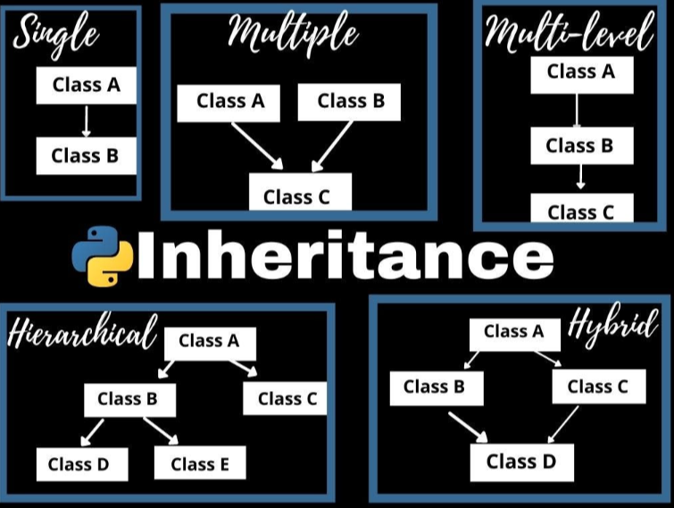
Object Oriented Programming &File Handling
Python Inheritance: Inheritance is the capability of one class to derive or inherit the properties from another class. The class that derives properties is called the derived class or child class and the class from which the properties are being derived is called the base class or parent class.
Types of Inheritance:
Single Inheritance
Multilevel Inheritance
Hierarchical Inheritance
Multiple Inheritance

Slide 15
Object Oriented Programming &File Handling
Parent class is the class being inherited from, also called base class.
Child class is the class that inherits from another class, also called derived class.
Single level
class A:
print("hello in base class")
class B(A):
print("in derived class")
ob=B()
Output:
hello in base class
in derived class

Slide 16
Object Oriented Programming &File Handling
Multiple Inheritance:
class A:
name =' '
class B:
age=0
class C(A,B): #When two or more classes are used for deriving a new class
weight=' '
def read(self):
self.name=input("enter name")
self.age=int(input("enter age"))
self.weight=int(input("enter weight"))

Slide 17
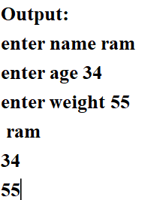
Object Oriented Programming &File Handling
def display(self):
print(self.name)
print(self.age)
print(self.weight)
ob1=C()
ob1.read()
ob1.display()

Slide 18
Object Oriented Programming &File Handling
Method Overriding: class A:
def display(self):
print("base class")
class B(A):
def display(self): #Method Overriding (same name and same header)
print("derived class")
ob=B()
ob.display() Output: derived class
#can use super().method_name to access overridden method

Slide 19
Object Oriented Programming &File Handling
Multilevel Inheritance: class A:
name =' '
class B(A):
age=0
class C(B):
weight=' '
def read(self):
self.name=input("enter name")
self.age=int(input("enter age"))
self.weight=int(input("enter weight"))

Slide 20
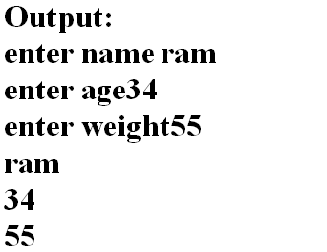
Object Oriented Programming &File Handling
def display(self):
print(self.name)
print(self.age)
print(self.weight)

Slide 21

Object Oriented Programming &File Handling
class A:
def display(self):
print("base class")
class B(A):
def display(self):
print("derived class")
super().display()
ob=B()
ob.display()

Slide 22
Object Oriented Programming &File Handling
Python Polymorphism: In object oriented Programming Python, Polymorphism simply means having many forms. For example, we need to determine if the given species of birds fly or not, using polymorphism we can do this using a single function.

Slide 23
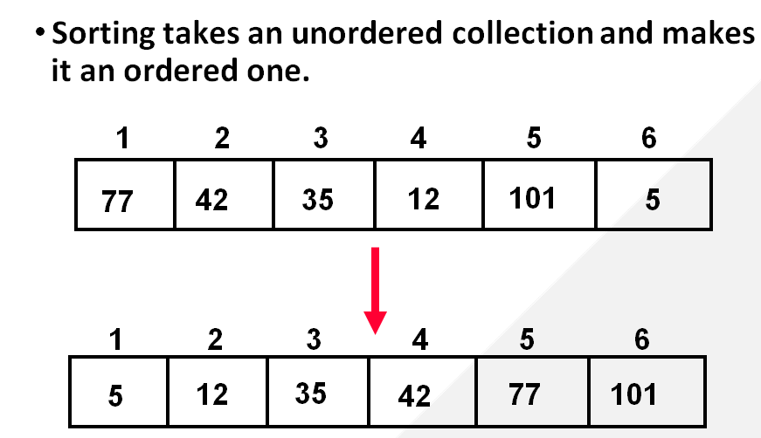
Object Oriented Programming &File Handling
Sorting: Sorting is the process of arranging data in a particular order, typically in ascending or descending sequence. This is a fundamental operation in computer science and data processing, as it helps in efficiently managing and retrieving data.
Selection Sort
Bubble Sort
Insertion Sort
Merge Sort
Quick Sort

Slide 24
Object Oriented Programming &File Handling
Linear Search: Linear Search is a method for searching an element in a collection of elements. In Linear Search, each element of the collection is visited one by one in a sequential fashion to find the desired element. Linear Search is also known as Sequential Search.
Time Complexity:
Best Case: In the best case, the key might be present at the first index. So the best case complexity is O(1)
Worst Case: In the worst case, the key might be present at the last index i.e., opposite to the end from which the search has started in the list. So the worst-case complexity is O(N) where N is the size of the list.
Average Case: O(N)

Slide 25
Object Oriented Programming &File Handling
Binary Search: Binary search is a search algorithm used to find the position of a target value within a sorted array. It works by repeatedly dividing the search interval in half until the target value is found or the interval is empty. The search interval is halved by comparing the target element with the middle value of the search space.
Time Complexity:
Best Case: O(1)
Average Case: O(log N)
Worst Case: O(log N)

Slide 26
Object Oriented Programming &File Handling
Selection Sort: It is a simple and efficient sorting algorithm that works by repeatedly selecting the smallest (or largest) element from the unsorted portion of the list and moving it to the sorted portion of the list.
Time Complexity: The time complexity of Selection Sort is O(N²) as there are two nested loops:
One loop to select an element of Array one by one = O(N)
Another loop to compare that element with every other Array element = O(N)
Therefore overall complexity = O(N) * O(N) = O(N*N) = O(N²)

Slide 27
Object Oriented Programming &File Handling
Insertion Sort: It is a simple sorting algorithm that works by building a sorted array one element at a time. It is considered an “in-place” sorting algorithm, meaning it doesn’t require any additional memory space beyond the original array.
Time Complexity of Insertion Sort
Best case: O(n), If the list is already sorted, where n is the number of elements in the list.
Average case: O(n²), If the list is randomly ordered
Worst case: O(n²), If the list is in reverse order

Slide 28
Object Oriented Programming &File Handling
Merge Sort: It is a sorting algorithm that follows the divide-and-conquer approach. It works by recursively dividing the input array into smaller subarrays and sorting those subarrays then merging them back together to obtain the sorted array.
Time Complexity:
Best Case: O(n log n), When the array is already sorted or nearly sorted.
Average Case: O(n log n), When the array is randomly ordered.
Worst Case: O(n log n), When the array is sorted in reverse order.
Space Complexity: O(n), Additional space is required for the temporary array used during merging.

Slide 29
Object Oriented Programming &File Handling
Quick Sort: It is a sorting algorithm based on the Divide and Conquer algorithm that picks an element as a pivot and partitions the given array around the picked pivot by placing the pivot in its correct position in the sorted array.
Time Complexity:
Best Case: Ω (N log (N)) The best-case scenario for quicksort occur when the pivot chosen at the each step divides the array into roughly equal halves.
Average Case: θ ( N log (N)) Quicksort’s average-case performance is usually very good in practice, making it one of the fastest sorting Algorithm.
Worst Case: O(N2) The worst-case Scenario for Quicksort occur when the pivot at each step consistently results in highly unbalanced partitions.

Slide 30
Object Oriented Programming &File Handling
Summary of Time Complexities
Algorithm | Best Case | Average Case | Worst Case
Linear Search | O(1) | O(n) | O(n)
Binary Search | O(1) | O(log n) | O(log n)
Selection Sort | O(n^2) | O(n^2) | O(n^2)
Bubble Sort | O(n) | O(n^2) | O(n^2)
Insertion Sort | O(n) | O(n^2) | O(n^2)
Merge Sort | O(n log n) | O(n log n) | O(n log n)
Quick Sort | O(n log n) | O(n log n) | O(n^2)

Slide 31
Object Oriented Programming &File Handling
File Handling: The concept of file handling has stretched over various other languages, but the implementation is either complicated or lengthy, but alike other concepts of Python, this concept here is also easy and short.
Python treats file differently as text or binary and this is important. Each line of code includes a sequence of characters and they form text file. Each line of a file is terminated with a special character, called the EOL or End of Line characters like comma {,} or newline character.

Slide 32
Object Oriented Programming &File Handling
Advantages of File Handling in Python
Versatility: File handling in Python allows you to perform a wide range of operations, such as creating, reading, writing, appending, renaming, and deleting files.
Flexibility: File handling in Python is highly flexible, as it allows you to work with different file types (e.g. text files, binary files, CSV files, etc.), and to perform different operations on files (e.g. read, write, append, etc.).
User–friendly: Python provides a user-friendly interface for file handling, making it easy to create, read, and manipulate files.
Cross-platform: Python file-handling functions work across different platforms (e.g. Windows, Mac, Linux), allowing for seamless integration and compatibility.

Slide 33
Object Oriented Programming &File Handling
Disadvantages of File Handling in Python
Error-prone: File handling operations in Python can be prone to errors, especially if the code is not carefully written or if there are issues with the file system (e.g. file permissions, file locks, etc.).
Security risks: File handling in Python can also pose security risks, especially if the program accepts user input that can be used to access or modify sensitive files on the system.
Complexity: File handling in Python can be complex, especially when working with more advanced file formats or operations. Careful attention must be paid to the code to ensure that files are handled properly and securely.

Slide 34
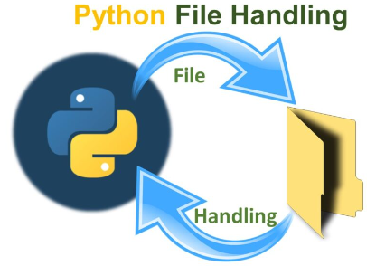
Object Oriented Programming &File Handling
Need: All programs need the input to process and output to display data. And everything needs a file as name storage compartments on computers that are managed by OS. Though variables provide us a way to store data while the program runs, if we want out data to persist even after the termination of the program, we have to save it to a file.

Slide 35
Object Oriented Programming &File Handling
Open() function:The key function for working with files in Python is the open() function.
It takes two parameters; filename, and mode.
There are four different methods (modes) for opening a file:
“r”: Read - Default value. Opens a file for reading, error if the file does not exist.
“a”: Append - Opens a file for appending and will append at the end of the file., creates the file if it does not exist.
“w”: Write - Opens a file for writing and will overwrite the content of the file if file already exists, creates the file if it does not exist

Slide 36
Object Oriented Programming &File Handling
“x”: Create - Creates the specified file, returns an error if the file exists.
“r+” : for both read and write
“rb” : for reading binary data
In addition you can specify if the file should be handled as binary or text mode
“t”: Text - Default value. Text mode
“b” : Binary - Binary mode (e.g. images)
To open a file for reading it is enough to specify the name of the file:
ob1=open("demo.txt") # file will be opened in read mode.
ob1= open("demofile.txt", "rt")

Slide 37
Object Oriented Programming &File Handling
read() function:
If you want to read content from the file then read() function is used.
str read(int no) returns a specified no of characters from a file. if argument is omitted then entire content of file is read
Example:
print(f.read(5))
You can return one line by using the readline() method.
str readline() returns the next line of a file as a string
Close Files It is a good practice to always close the file when you are done with it.
f.close()
list readlines() returns a list containing all the lines in a file

Slide 38
Object Oriented Programming &File Handling
Example: Creating a function that will open a file named demo in write mode then writing some text in file reading the text from file and printing the content.
def fun():
ob1=open("t.txt","w")
ob1.write("hello\n") #write(str)
ob1.write("world")
ob1.close()
ob1=open("t.txt","r")
text=ob1.read()
print(text)
ob1.close()
fun()

Slide 39
Object Oriented Programming &File Handling
Appending in file: Open the file "demo.txt" and append content to the file.
f = open("demo.txt", "a")
f.write("Now the file has more content!")
f.close()
#open and read the file after the appending:
f = open("demo.txt", "r")
print(f.read())
Create a New File: To create a file in python use open command either with “x”, “a” or “w” mode.
Delete a File: To delete a file, you must import the OS module, and run its os.remove() function.
Example
import os os.remove("demo.txt")

Slide 40
Object Oriented Programming &File Handling
Check if File exist: To avoid getting an error, you might want to check if the file exists before you try to delete it.
Example:
import os if os.path.exists("demo.txt"): os.remove("demofile.txt") else: print("The file does not exist")

Slide 41
Object Oriented Programming &File Handling
Writing numbers to a file:
#Writing numbers to a file
def fun():
ob1=open("demo1.txt","w")
for i in range(50):
i=str(i)
ob1.write(i)
ob1.write(" ") #write(str)
ob1.close()
fun()

Slide 42
Object Oriented Programming &File Handling
Copy Content from one File to Another
def fun():
ob1=open("demo.txt","r")
ob2=open("demo2.txt","w")
for i in ob1:
ob2.write(i)
ob2.close()
ob2=open("demo2.txt","r")
text=ob2.read()
print(text)
ob1.close()
ob2.close()
fun()

Slide 43
Object Oriented Programming &File Handling
SEEK FUNCTION: file_object.seek(offset,whence) whence (by default 0) indicates the point of reference (0 beginning of file, 1 current position, 2 end of the file), offset indicates the no of bytes.
Example:
ob=open("test.txt",'w+')
print(ob.write('oh!god!save earth!'))
ob.seek(3)
print(ob.readline())
ob.seek(0)
ob.truncate() # to delete entire data but not the file fileobject.truncate()
print(ob.readline())
Output:
god!save earth!

Slide 44
Object Oriented Programming &File Handling
OS MODULE FUNCTIONS:
>>> import os
>>> os.getcwd() #get current working directory
'C:\\Users\\hp\\Desktop\\Python'
>>> os.chdir('C:\\Users\\hp\\Desktop') #to change the directory
>>> os.getcwd()
'C:\\Users\\hp\\Desktop'
>>> os.mkdir('prac') #to make new directory
>>> os.chdir('C:\\Users\\hp\\Desktop\\prac')
>>> os.listdir('C:\\Users\\hp\\Desktop\\python') #to list directories and files

Slide 45
Object Oriented Programming &File Handling
>>> os.rename('prac','test') #to rename the directory
>>> os.rmdir('C:\\Users\\hp\\Desktop\\test') #is used to remove a empty directory
>>> os.remove('C:\\Users\\hp\\Desktop\\Python\\demo.txt') #is used to remove a file
>>> import shutil
>>> shutil.rmtree('C:\\Users\\hp\\Desktop\\test') #delete an entire directory tree

Slide 46
Object Oriented Programming &File Handling
SUGGESTED TEXTBOOKS
Ashok Namdev Kamthane, Programming and Problem Solving with Python, Mc Graw Hill Education Publication, 1st Edition, November 2017.
Kenneth Lambert, Fundamentals of Python :First Programs, Cengage Learning
Allen Downey, Think Python, O'Reilly Media, 2nd Edition,2015.
REFERENCE BOOKS
Rajaraman V,” Computer Oriented Numerical Methods”, Pearson Education.
Y. Daniel Liang, Introduction to Programming Using Python, Pearson.
Martin C.Brown, PYTHON The Complete REFERENCE, Tata McGraw-Hill
Education, 4th Edition, March 2018.

Slide 47
Outcomes
Department of Computer Science and Engineering (CSE)
• Implement Object-Oriented Programming concepts including classes, methods, inheritance, and polymorphism to create modular and reusable Python code.
• Perform file handling operations in Python, including reading from and writing to files in various modes, to effectively manage and manipulate data persistence.
• Analyze and select the most suitable searching and sorting algorithms for different programming scenarios, demonstrating understanding of their efficiency and use cases.
• Develop practical applications that integrate searching, sorting, OOP principles, and file handling to solve complex programming problems in Python.

Slide 48



Department of Computer Science and Engineering (CSE)

